Slide 2
Finance Update
Spend Summary Q2 | £
Honorarium Payments for chairs/leads | 8100
Additional Hours claimed | 900
Chair expenses | 250.41
Service User Payments and Expenses | 79.82
Events and Marketing Materials | 4056.07
Training | 252
Balance Forward (June) | 12818
Total Receipts | 17,885.35
Total Payments | 13,994.26
Q2 ending Sep 2023 | 16,709.09

Slide 3
Finance PLAn
Funding Awarded for 23/23 | 33,369.66
Additional funds awarded for pre-conception project work | 5,850.00
Total | 39,219.66
Co-chair funding - 12 days per month | 10,800.00
New Role - Enagagment Lead - 4 days per month | 7,200.00
New Role - Neonatal Lead - 2 days per month | 3,600.00
Chair expenses | 4,000.00
Service User payments and expenses | 2,000.00
Marketing/Events and unexpected costs | 2,500.00
Training | 1,000.00
Contingency fund - 3 months role hours only | 8,100.00
Total | 39,200.00

Slide 4
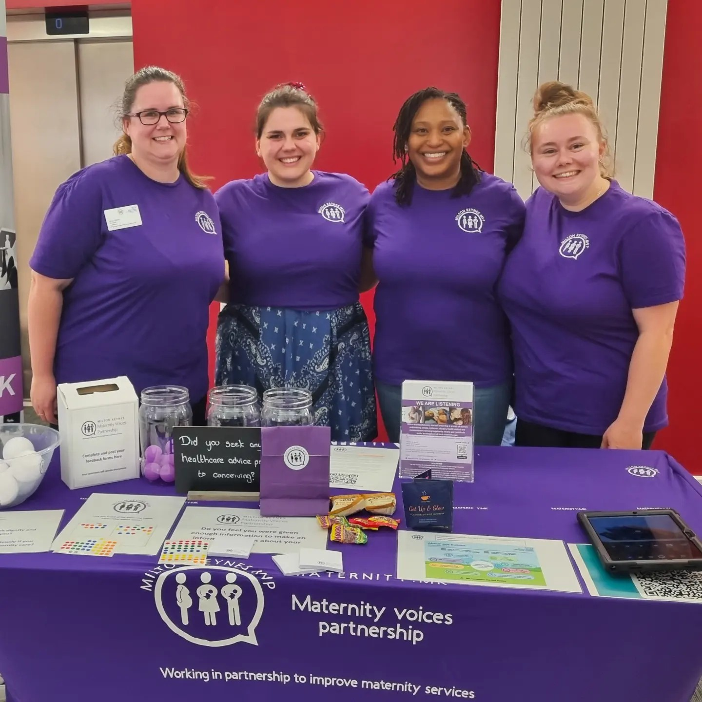
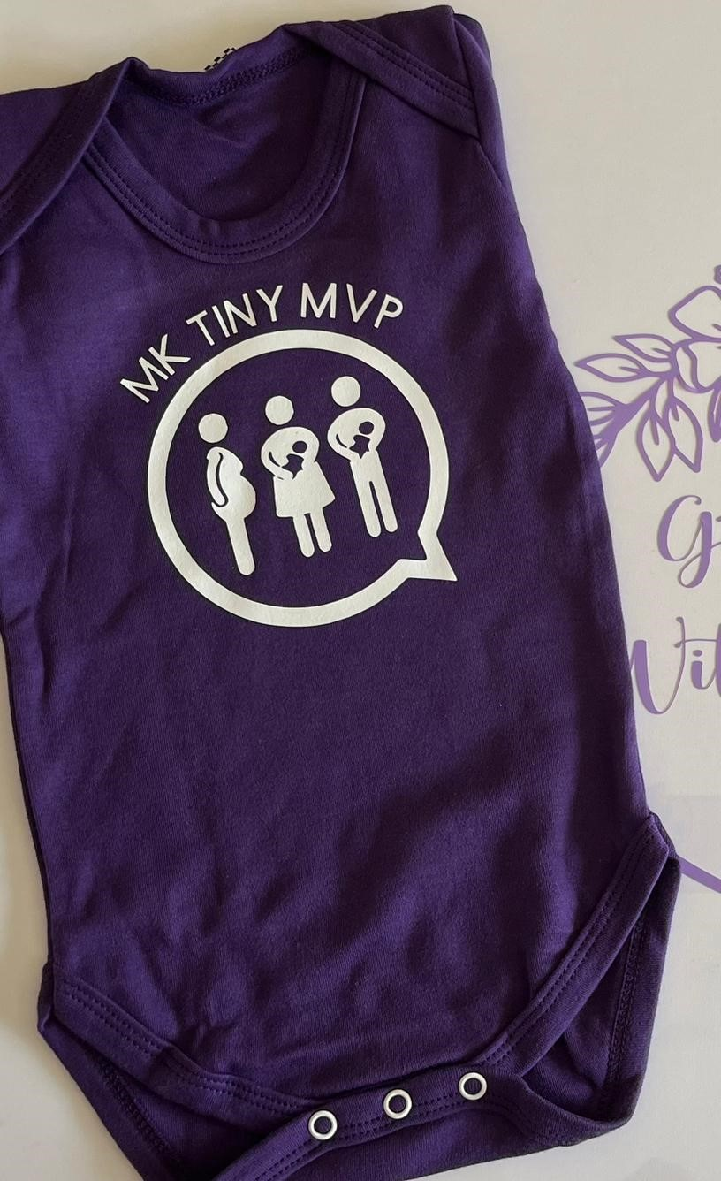
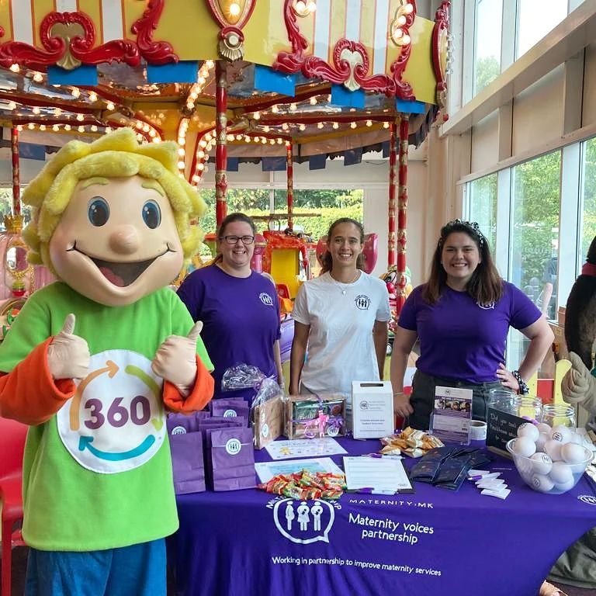
Updates
Congratulations to Temi on the birth of her beautiful daughter Omari
We had our first full Team Event at the MKUH Meet the Team.
It was a huge success that enabled us to engage with over 30 expectant birthing people and their partners/families.
Welcome
360 Play Parent and Toddle Fayre
We had 2 service user volunteers join us on the day. A great engagement event with lots of feedback. 4 new Parent Reps join our volunteer group.
As well as a chance to talk with the Mayor of MK about our work.
6 New Volunteers in our Service User Representative Group
Total of 46 members now!

Slide 5
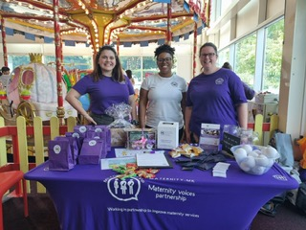
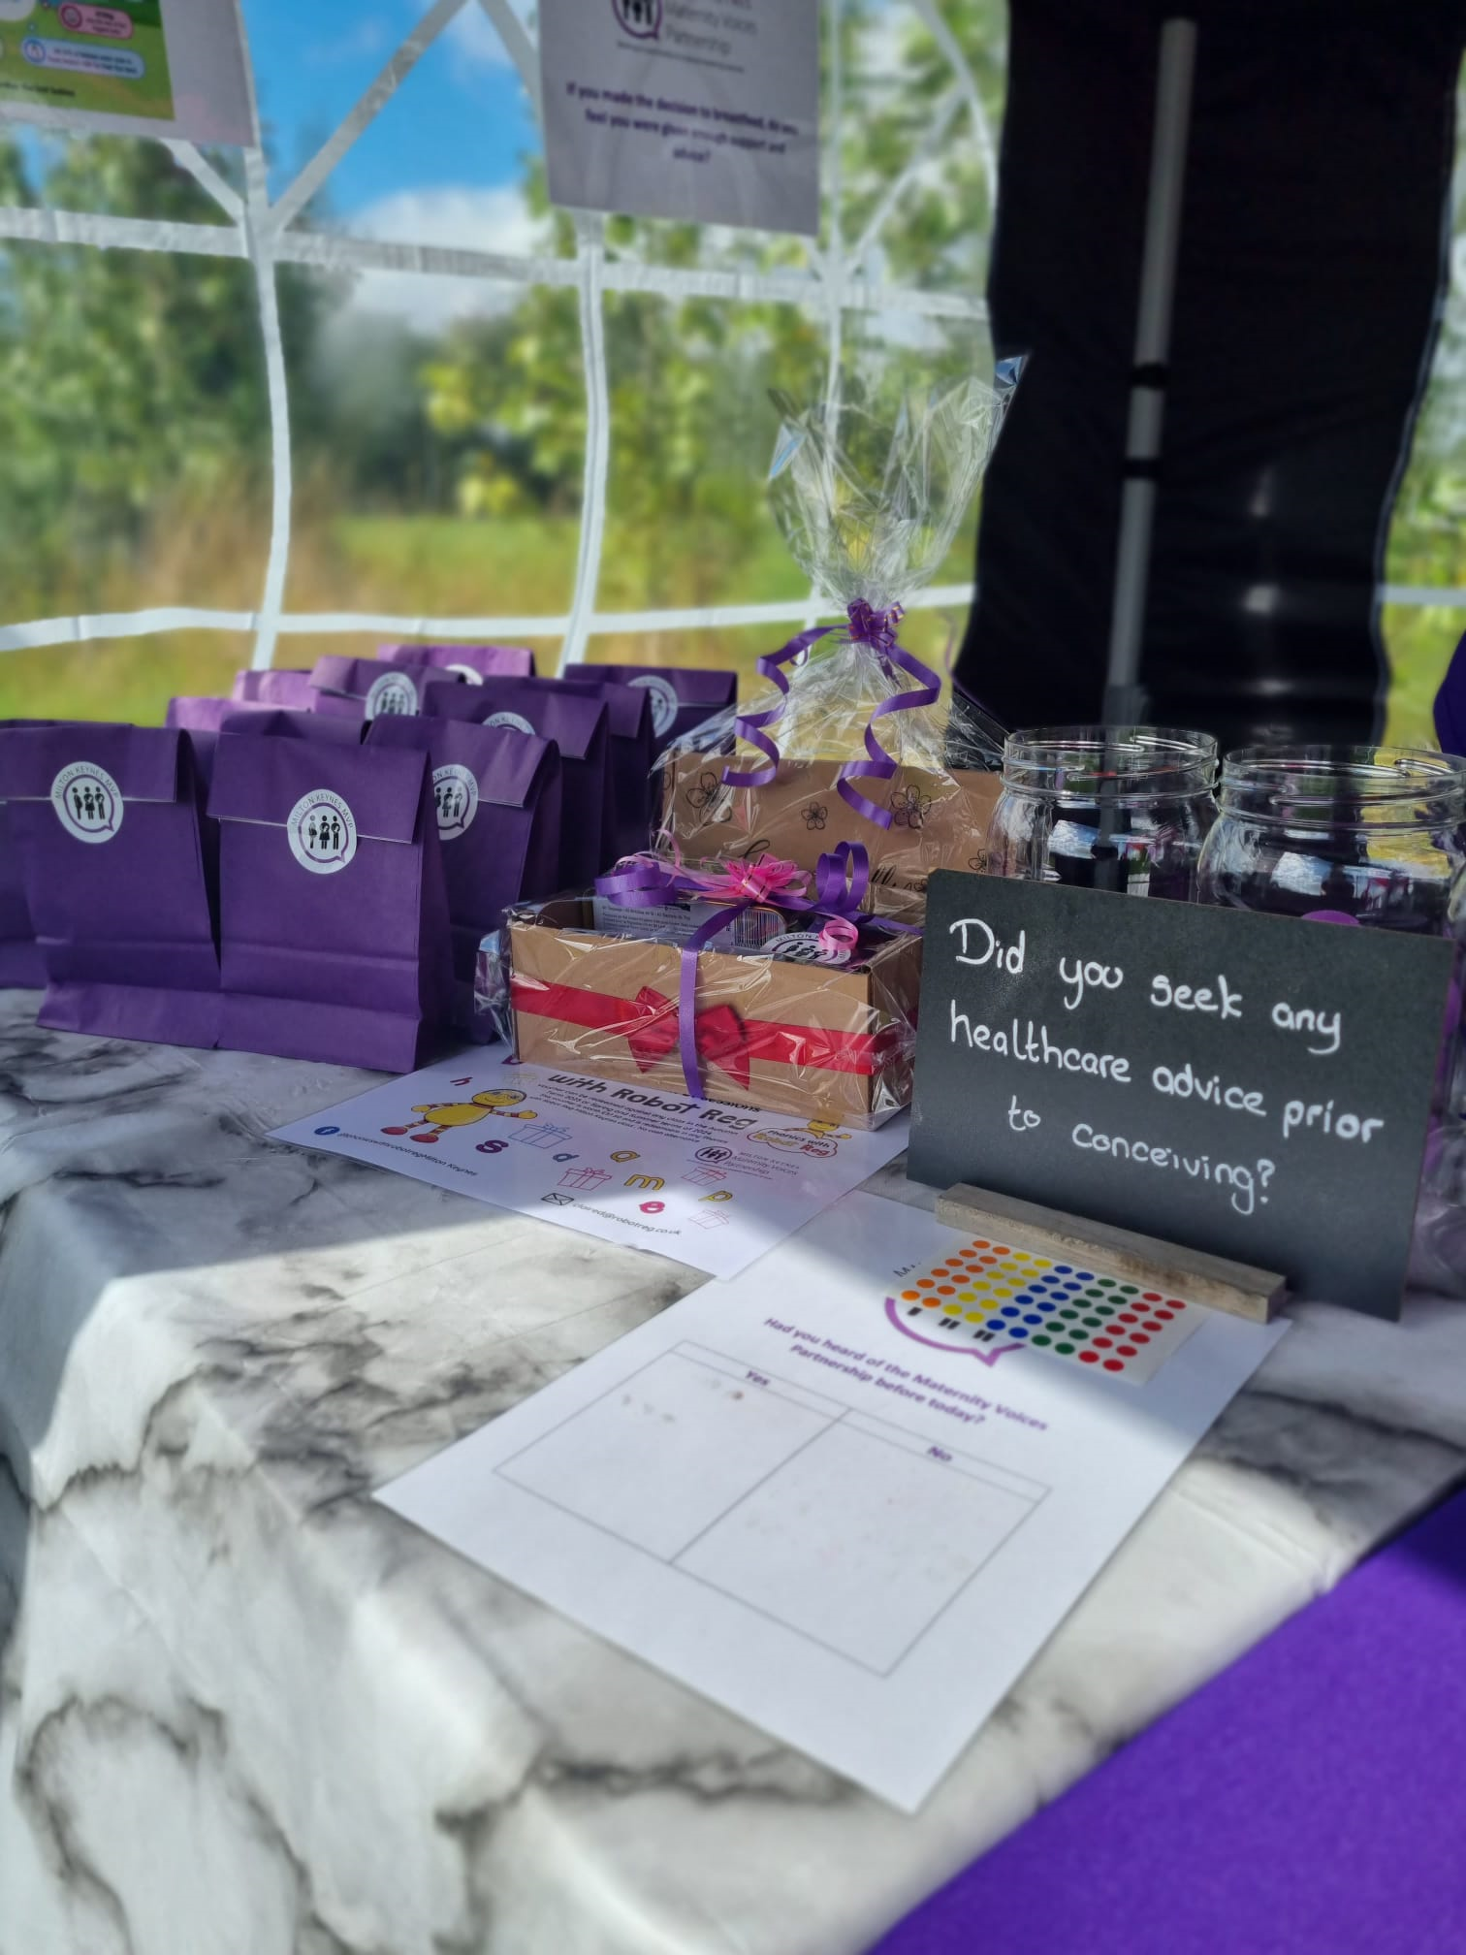
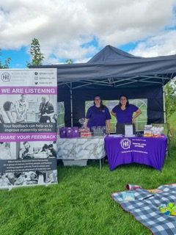
Engagement Lead Updates
Reaching out to various community groups to gather feedback and leading on social media content.
Attended and linked in with MK multiples group
Attended and linked in Milk Mentors Breastfeeding support group
Mindful Mama Picnic – event hosted by local Breastfeeding/ Hypnobirthing coach
Preconception project work –
Collaborated on survey to gather service user feedback
Created content to promote preconception support tools e.g. Tommy’s and Diabetes UK information
Promotion of survey alongside HealthWatch MK – one of our big successes of the quarter gathering over 50 responses to the preconception survey in the fist 3 weeks.

Slide 6
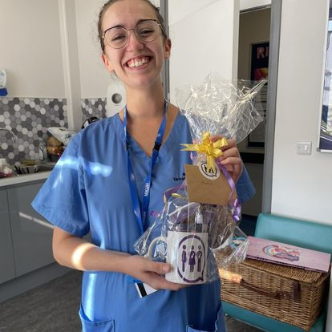
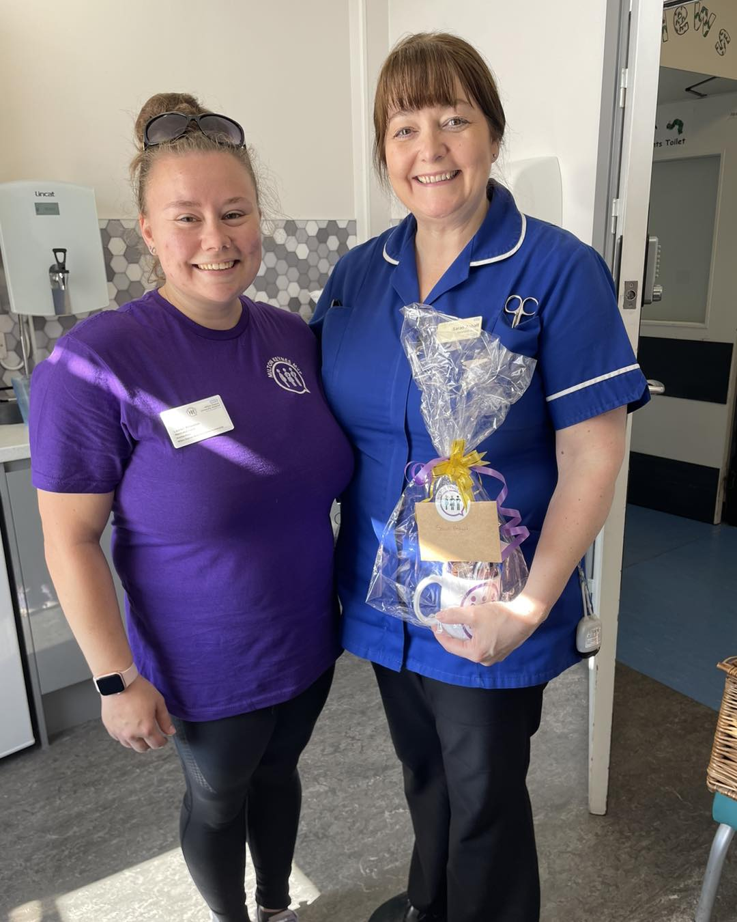
Neonatal Updates
Establishing role of the Neonatal Lead in MK MVP
Linking in with PAG groups for East of England and South West – ensuring collaborative working
Development of Neonatal Survey questions – due to be updated in the main MVP survey
Link with Charities – Peeps and Emily’s Star
Recruitment of volunteers with experience of neonatal services to the MK MVP parent rep group
Celebration of Neonatal Nurse Day – collating feedback and presenting staff recognised for their hard work with a thank you gift.

Slide 7
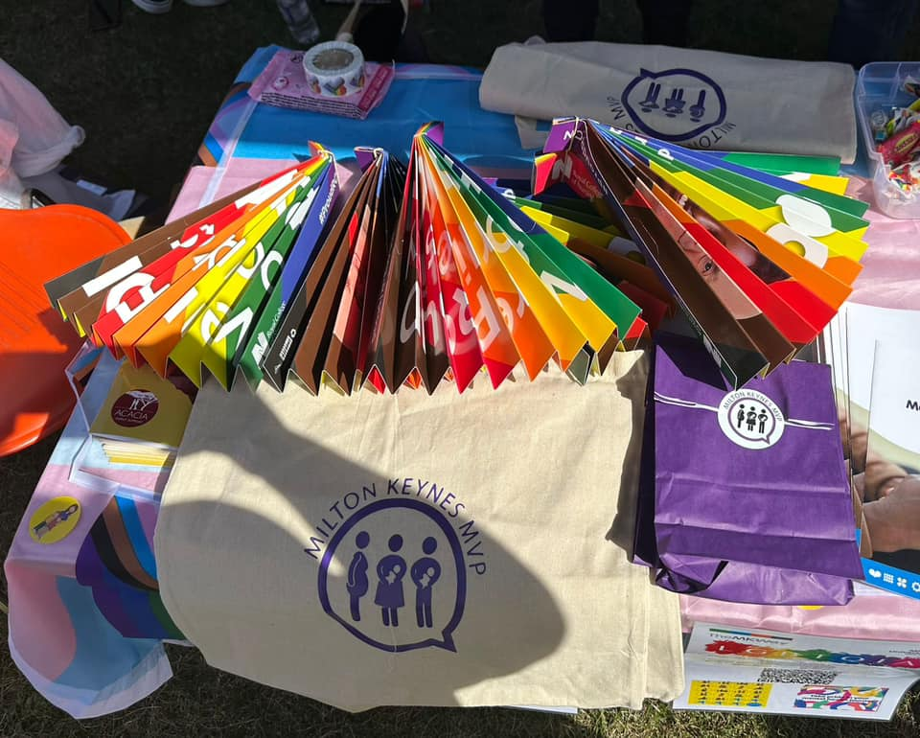
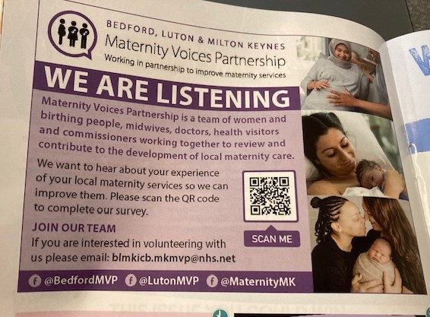
Raising the Profile
Although unable to attend Pride ourselves we were really grateful to the MKUH and CNWL Perinatal Mental Health Team taking our goody bags to hand out at their stand
Toddle About Advert – 3rd Advert now out in print – supporting with directing people to our survey and website.
Increased number of places where our leaflet is being displayed

Slide 8
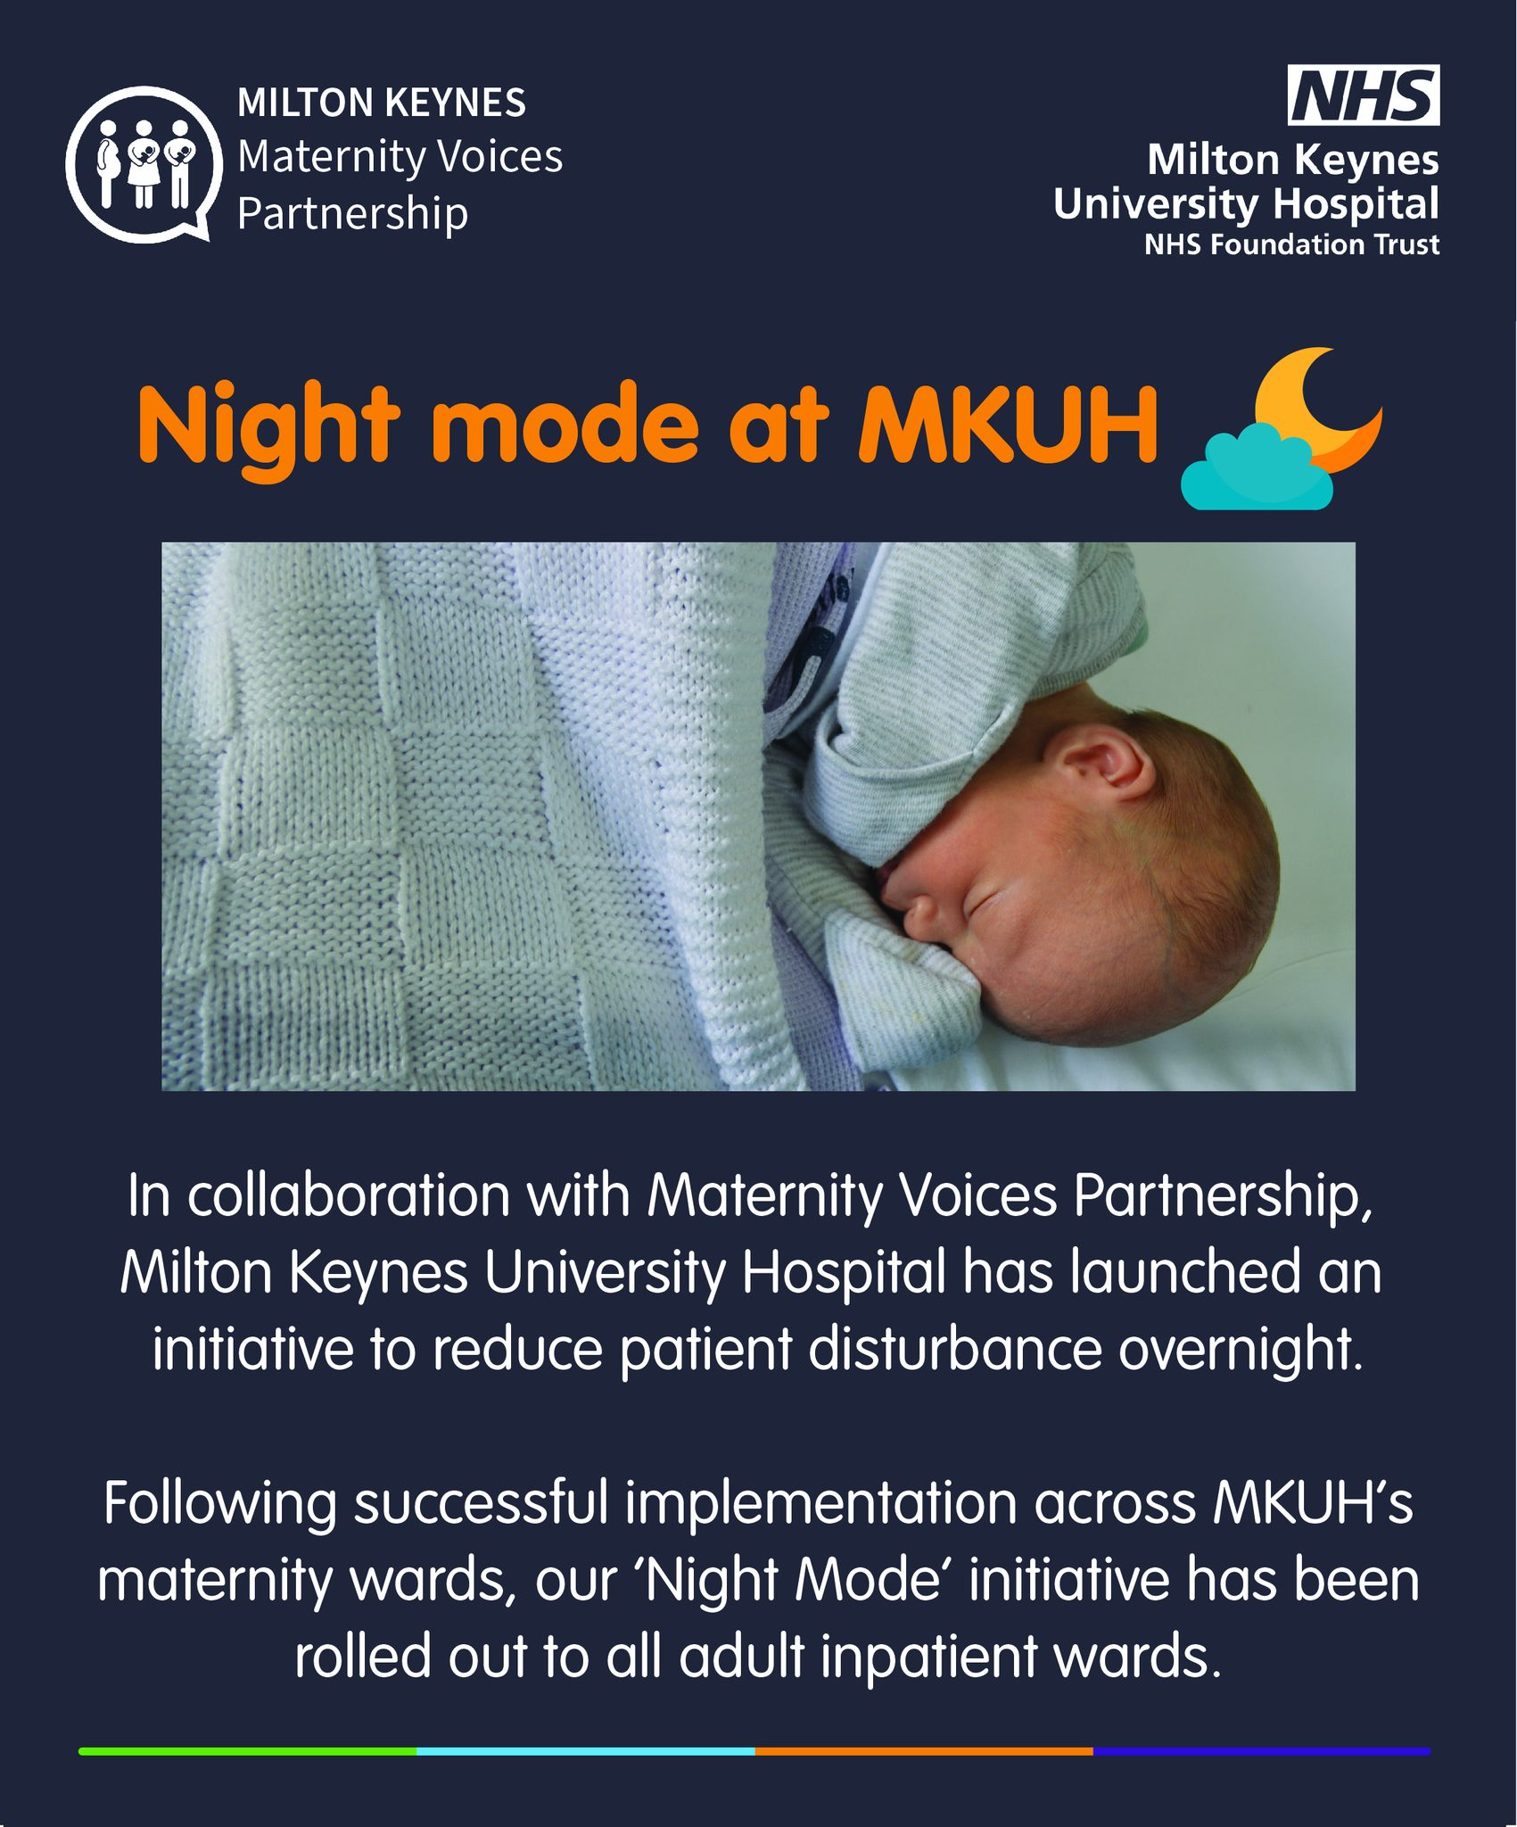
Social Media
Increased our social media presence across Facebook and Instagram
Numerous updates and posts created to improve engagement and inform service users.
Including comms from MKUH Maternity Services – postnatal clinics, bereavement support groups, night mode, Meet the Team event.
In numbers:
Followers 2760 on FB and 878 Instagram
Thankyou Thursday post reached 1,400
Most Engaged with posts were Night Mode 910 and Neonatal Nurse Day 888

Slide 9
Feedback Themes and Actions
Maternity Statistics Infographic post
-ongoing requests for information to be shared on % of inductions, caesareans, vaginal birth, assisted birth
- difficulty finding this data on the MKUH website or on national information sites
- it supports service user choice when deciding where to give birth
- in-line with what neighbour hospital sites produces infographics on monthly
UPDATE – infographic will be including neonatal data due to be introduced next month – to include admissions to Neonatal
ACTIONS – still in discussions with MKUH for this information to be included at the request of Service Users, working with service leads, data lead and comms team

Slide 10
Feedback Themes and Actions
Caesarean Sections
- requests for Gentle c-sections/ maternal assisted c-sections - is this an option that can be supported at MKUH?
- clarity of language around the type of c-section, elected vs unplanned vs emergency ( elective implies choice which is not always the case) – these terms/definitions of caesarean can be very triggering and traumatic dependent on the experience and how the use of the term ‘emergency’ can instil fear
- what options are available for service users during c-sections e.g. music being played, lighting options, delayed cord clamping/ waiting for white, skin to skin,
- are options for caesarean discussed at birth preferences appointment
UPDATE – new project on improving the experience of caesarean birth attended last week, all feedback received provided at this meeting, and further discussions will be taking place to work collaboratively on improving the caesarean experience.

Slide 11
Feedback Themes and Actions
Homebirth
- Difficulty getting Pethidine and not clear on processes
Preconception
- lack of accessible information and not knowing where to go for this information
- UPDATE – also awaiting information from survey feedback as this is held by Health Watch and will be analysed after the survey has run for 3 months
Neonatal Feedback
- On the whole very positive feedback about experience of Neonatal services,
PLAN – to work with neonatal unit and attend a coffee morning once a month to begin building relationships and create links to gather feedback
Out of Area service users
- Duplication of appointments and missing information
Perinatal Mental Health
- Very positive feedback about the support and expertise provided from Perinatal Mental Health Team
- Sleep Hygiene Packs were really well received on the wards and service users hope this will continue to be provided

Slide 12
Upcoming Projects/Work
PROMPT Training –
Discharge Project – first meeting next week to look at how the process can be improved
Protected Learning Time – the MVP are working with the consultant midwife to gather case studies and feedback that will be used as part of training for staff
Caesarean Section – improving service user experience
Preconception project work – survey currently running and will be analysed end of November
Women’s Health Hub – BLMK ICB project in early stages
Healthy Lifestyle – aqua natal progress to update and exercise class potential
Interviews

Slide 13
Thank You For Listening

