Slide 2
Finance Update
Spend Summary | £
Honorarium Payments for Co-leads | 5400
Honorarium for leads | 1800
Additional Hours claimed | 1050
Chair expenses | 432.94
Service User Payments and Expenses | 100.85
Events and Marketing Materials | 504.48
Training | 96.89
Balance Forward (June) | 16,709
Total Receipts | 7098.39
Total Payments | 11,082.41
Q2 ending Dec 2023 | 12,715.98

Slide 3
Finance PLAn
Funding Awarded for 23/23 | 33,369.66
Additional funds awarded for pre-conception project work | 5,850.00
Total | 39,219.66
Co-chair funding - 12 days per month | 10,800.00
New Role - Enagagment Lead - 4 days per month | 7,200.00
New Role - Neonatal Lead - 2 days per month | 3,600.00
Chair expenses | 4,000.00
Service User payments and expenses | 2,000.00
Marketing/Events and unexpected costs | 2,500.00
Training | 1,000.00
Contingency fund - 3 months role hours only | 8,100.00
Total | 39,200.00

Slide 4
Updates
New Guidance released on the roles and expectations of an MVP – very exciting times as the guidance provides clear parameters for the work of the MVP – however there is still lots to be discussed and a need for collaboration between the MVP and LMNS/ICB to ascertain the best way forward
Plans are being made to prepare for becoming an MNVP as of April – and we are looking into hosting launch events in collaboration with venues and charities supporting Neonatal Ward across MK
We are really pleased to welcome the new Director of Maternity – Elaine who started in November. Already Elaine has some exciting plans on how MKUH Maternity Services and the MVP can work together to make a difference
Welcome
Behind the scenes work
Creation of a volunteer registration form being rolled out to our service user volunteers for more focused comms around opportunities to be involved
Longer term plans to support volunteers with training similar to that of MKUH Volunteers
Update to the feedback survey to include a section for feedback on Neonatal Experience
New Volunteers in our Service User Representative Group and to the New Staff at MKUH/CNWL
49 Total members now!

Slide 5
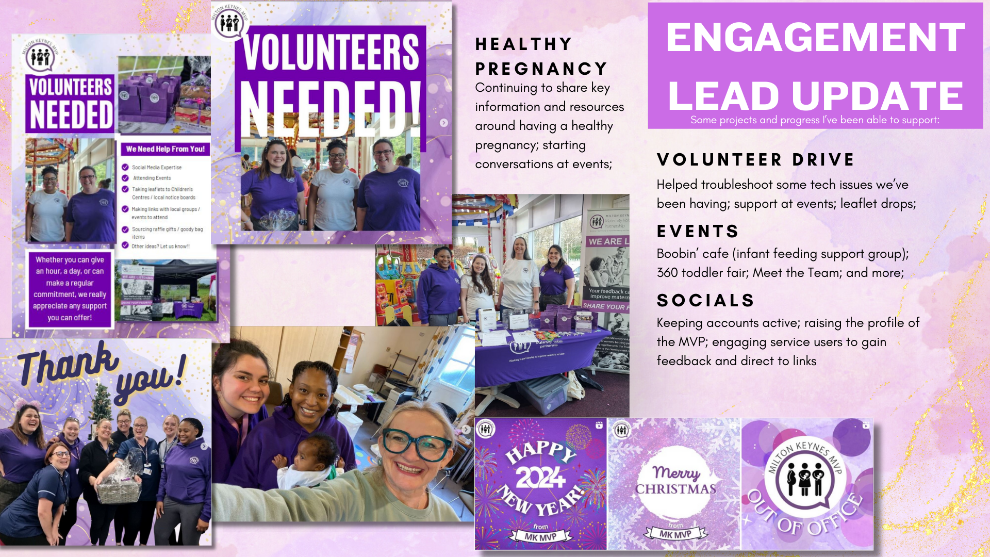
Engagement Lead Updates

Slide 6
Meet the Team info
We have started work on creating some Meet the Team posts for social media
The aim is an introduction to key team members, the different types of roles and what they mean eg who you might meet on your pregnancy journey
This has been received positive feedback in other areas such as ELFT and was discussed within our parent rep group as something that would be really welcomed.

Slide 7
Neonatal Updates
Continuing to establish role of Neonatal Lead in MK MVP.
Continuing to form and establish working relationships with staff members from NNU.
MVP updates in staff FICare Newsletter – Family integrated care.

Slide 8
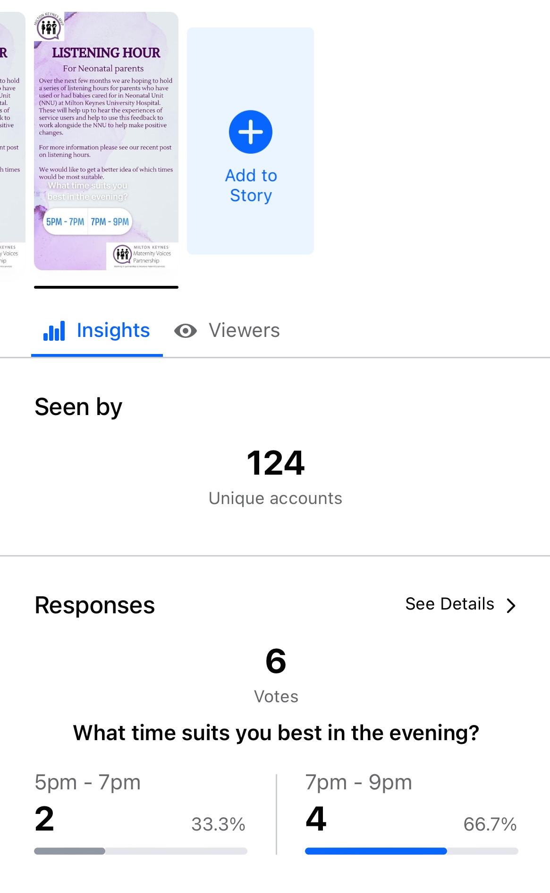
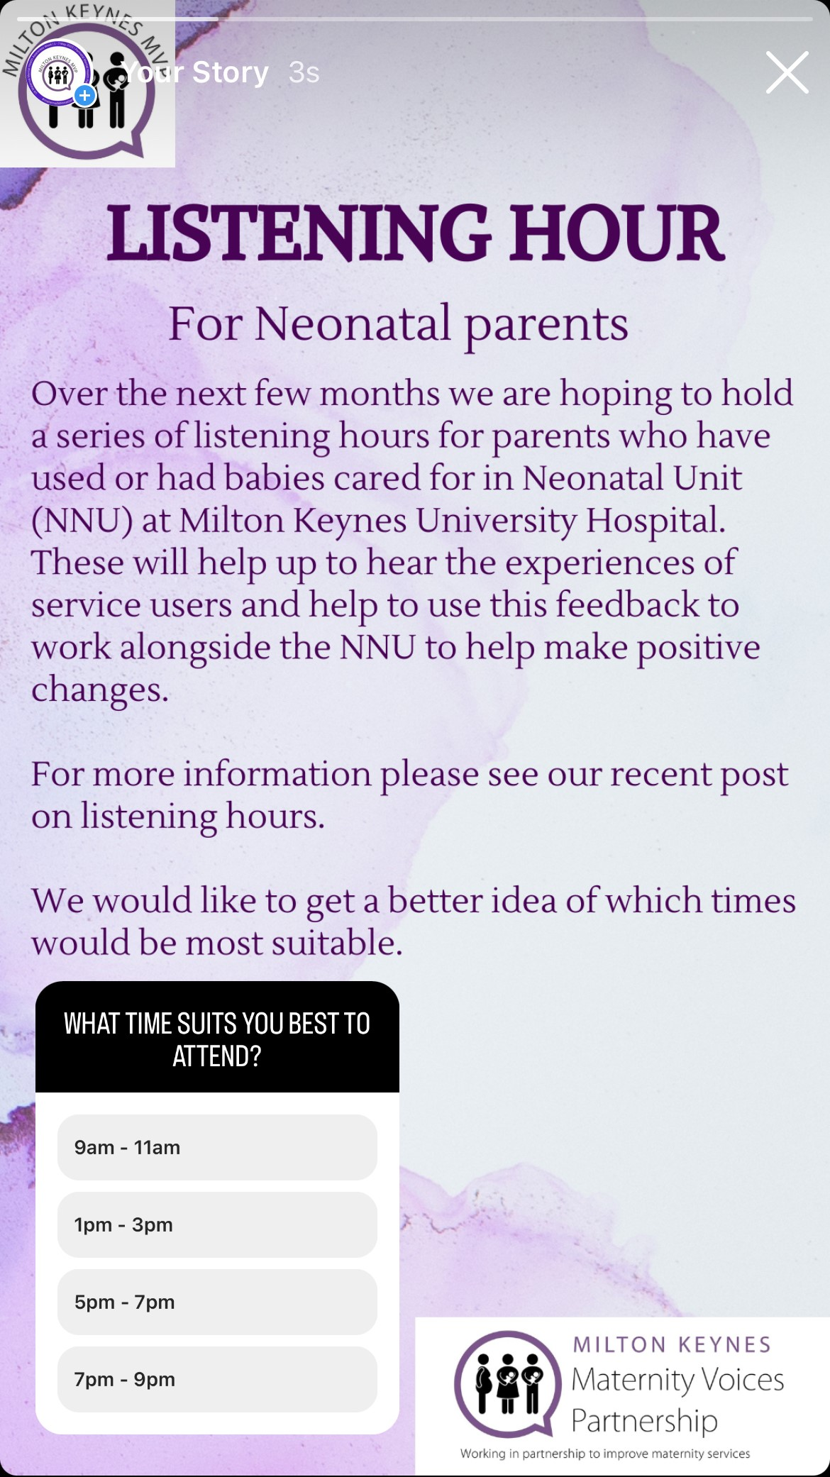
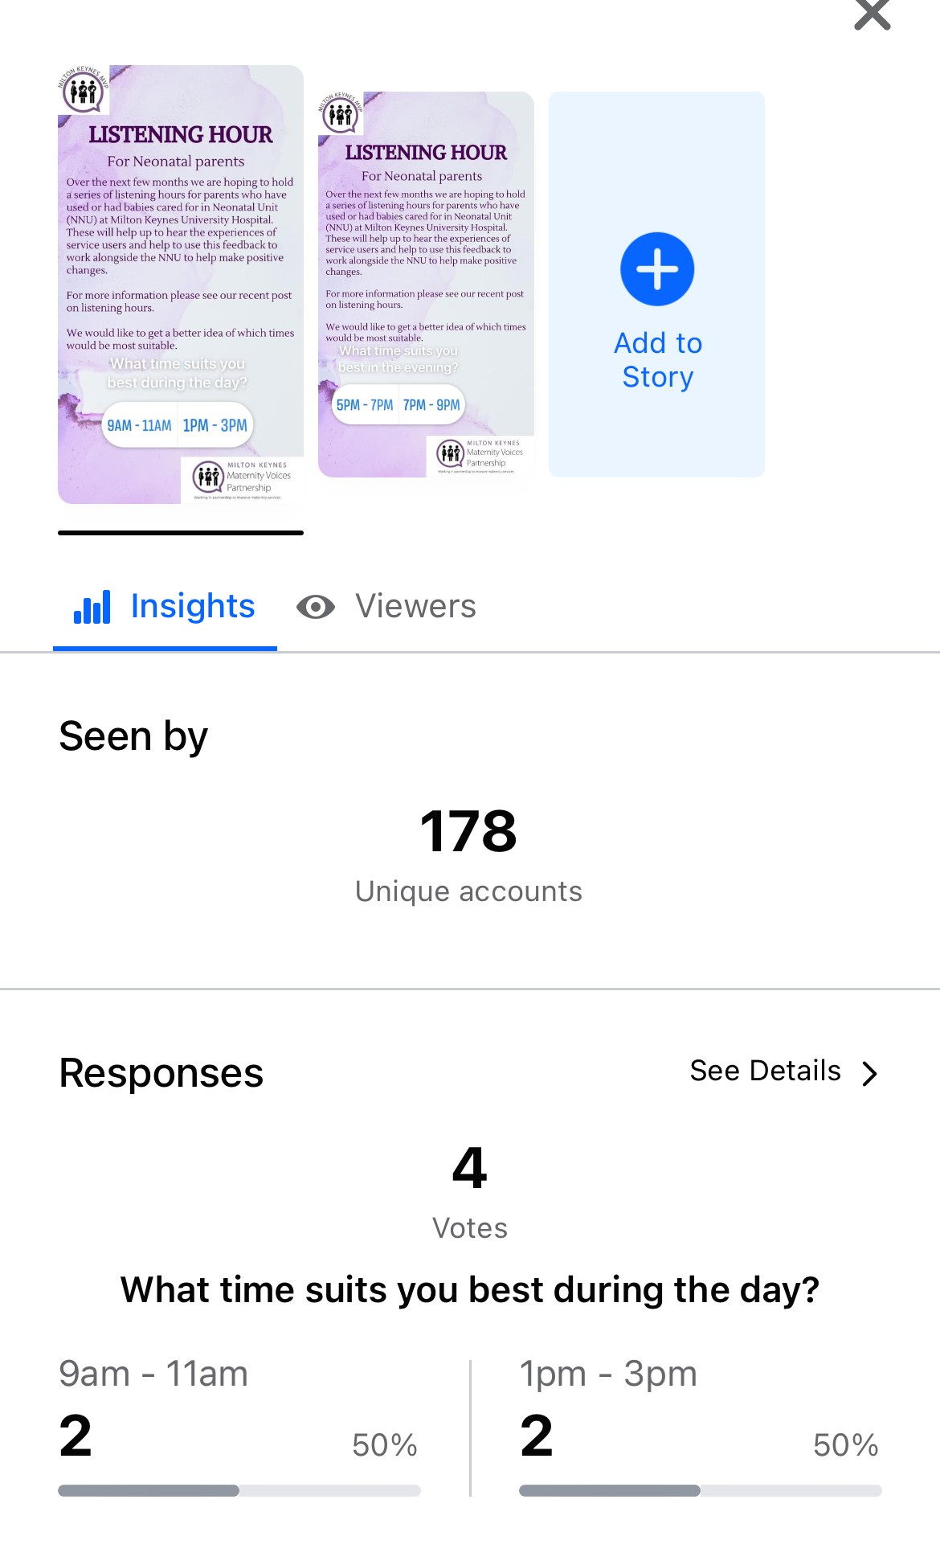
Neonatal Updates
Starting to run online listening events in the coming months.
Project looking at Communcation between Postnatal ward and Neonatal Unit.
Celebrated World Prematurity Day 2023.
Face to face feedback with service users whilst on NNU and gather feedback,

Slide 9
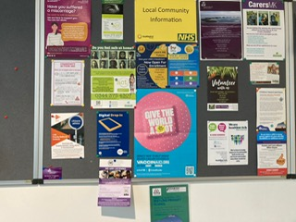
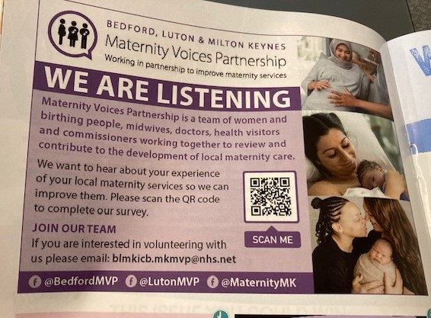
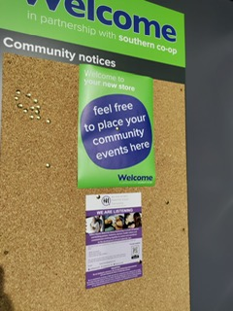
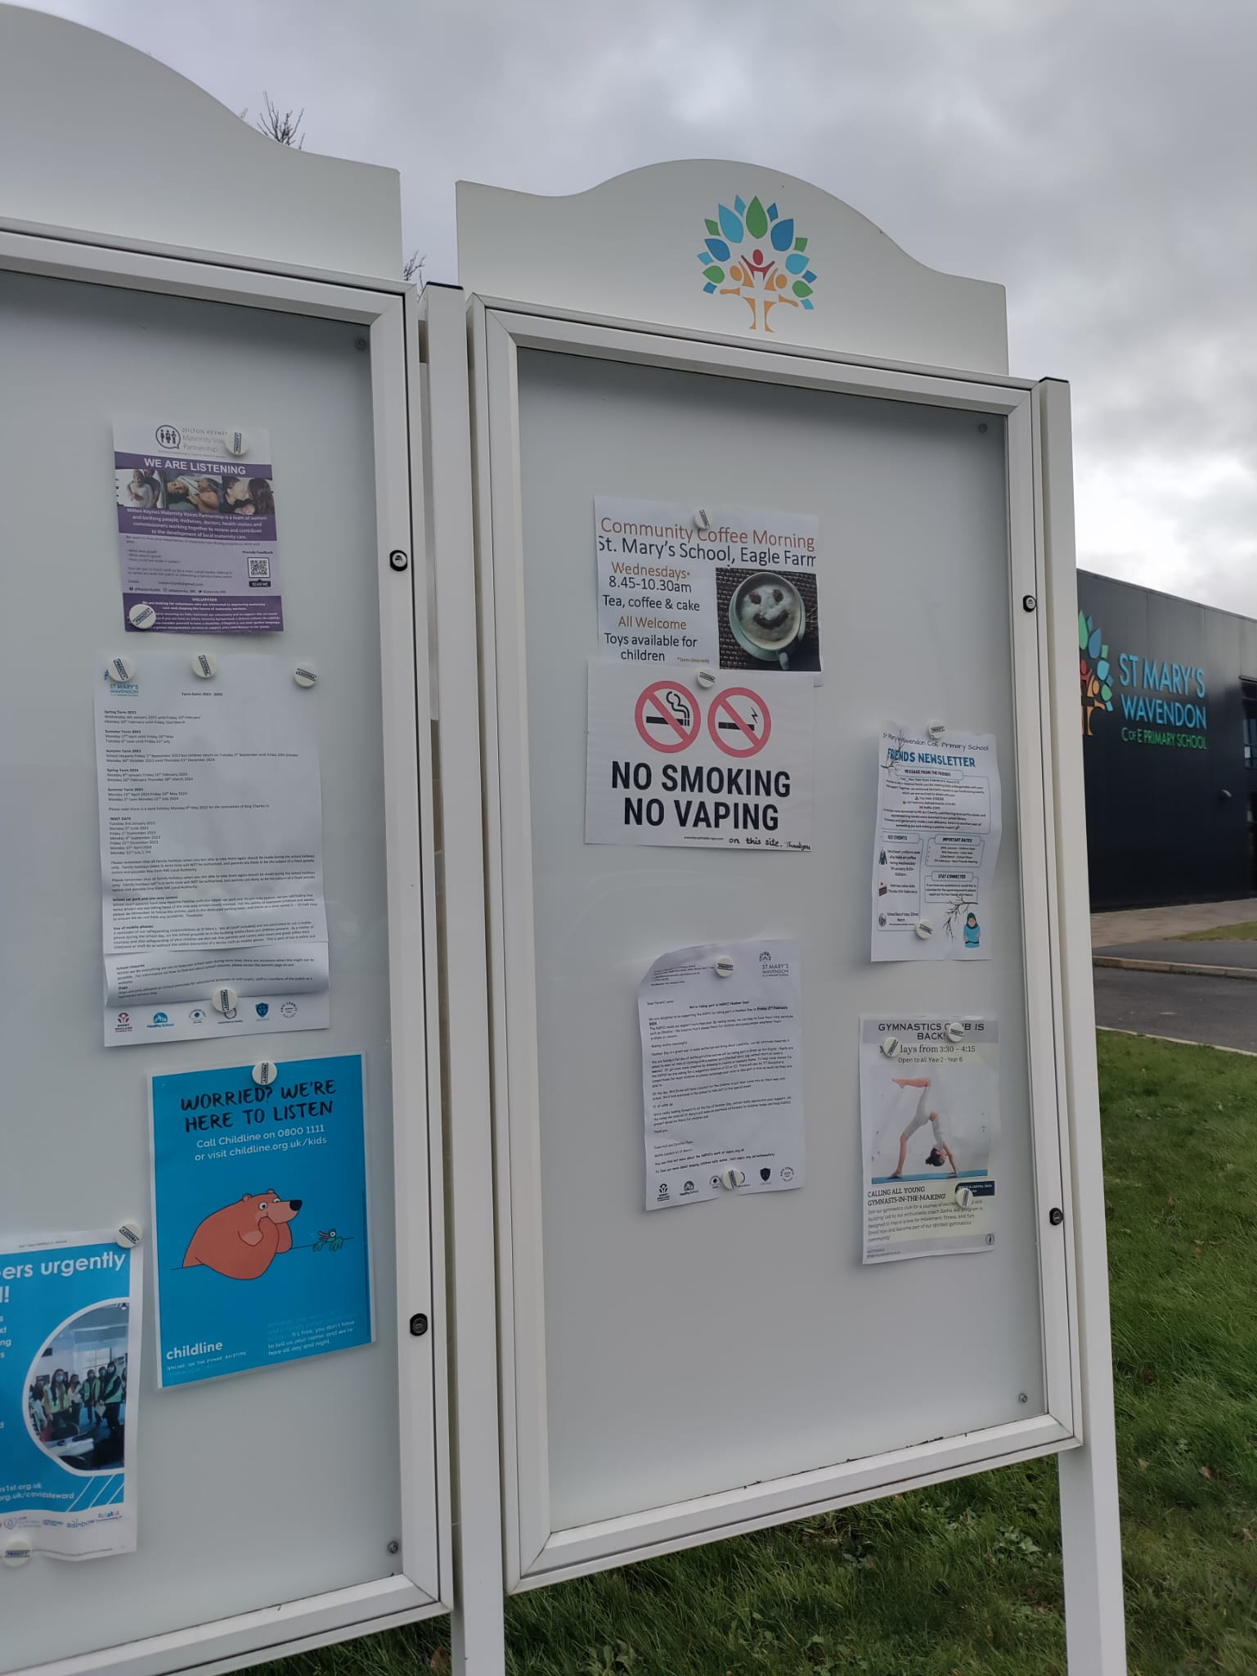
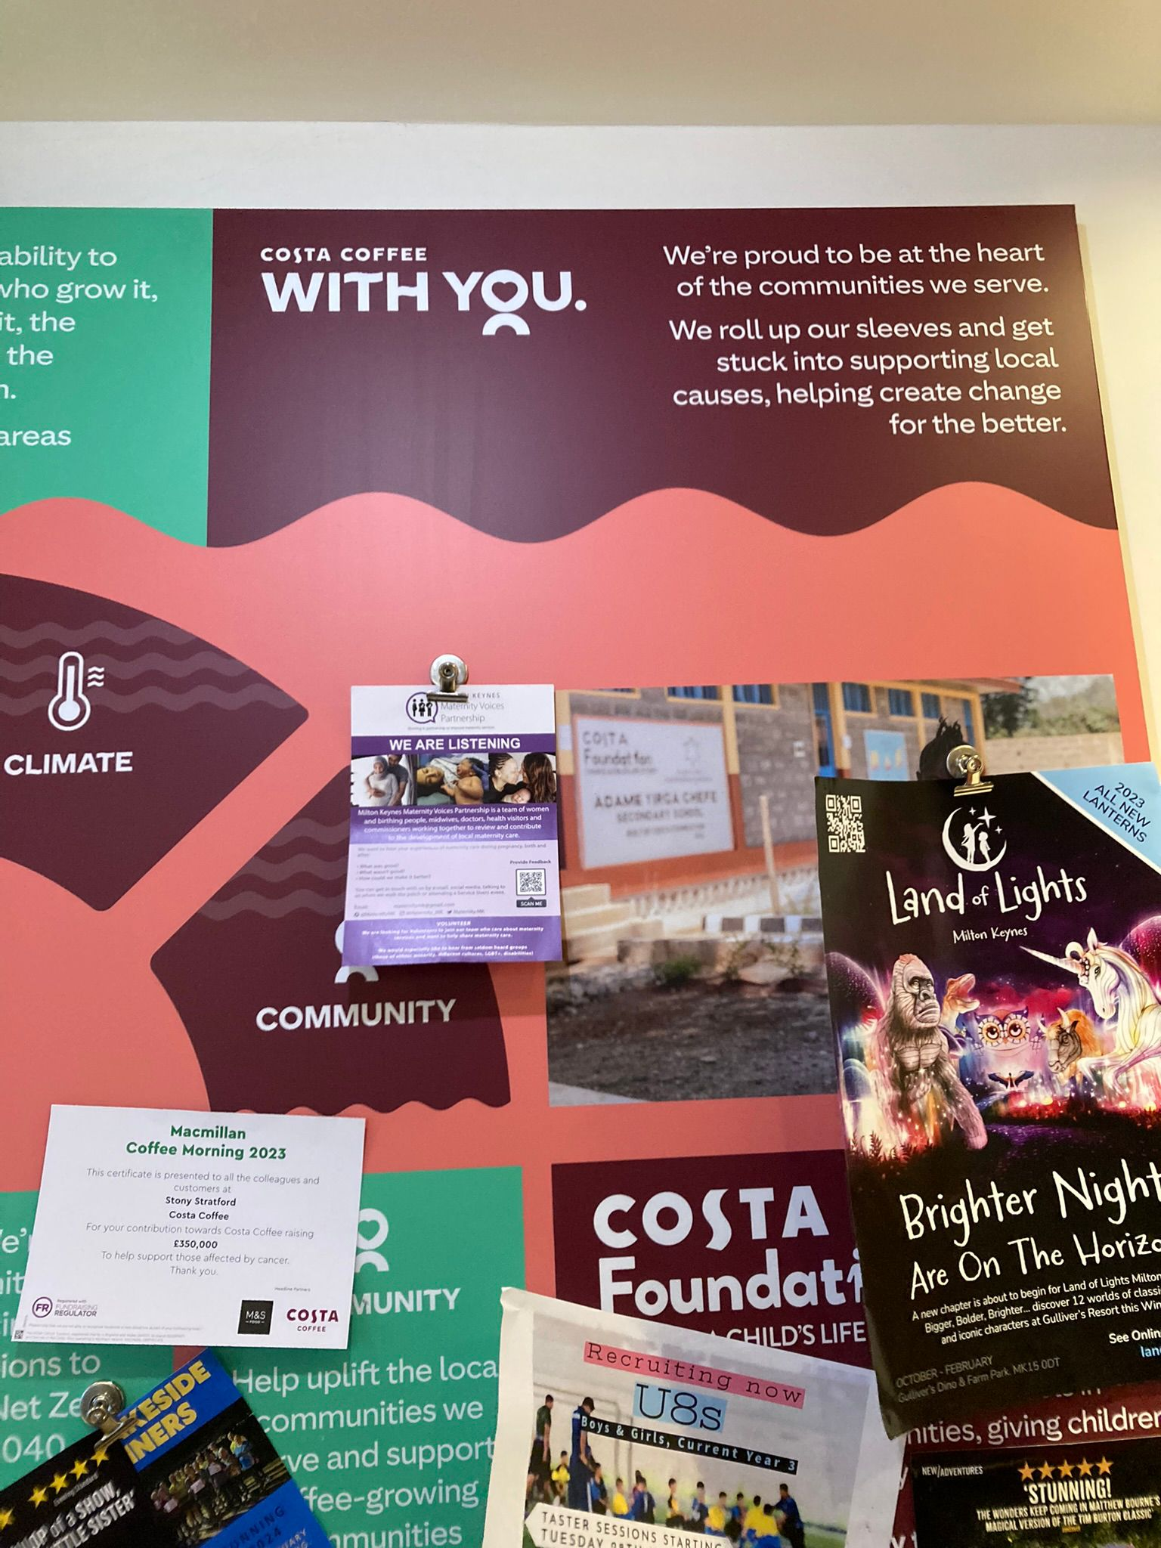
Raising the Profile
Toddle About Advert paid for another year – cost split between BLMK MVP’s
Increased number of places where our leaflet is being displayed – service user volunteers are helping to share and display leaflets in the community and at groups.
200 leaflets being handed out across pre-loved baby/toddler markets in Feb and March
Local Birth Support businesses handing out leaflets in goody bags at antenatal classes

Slide 10
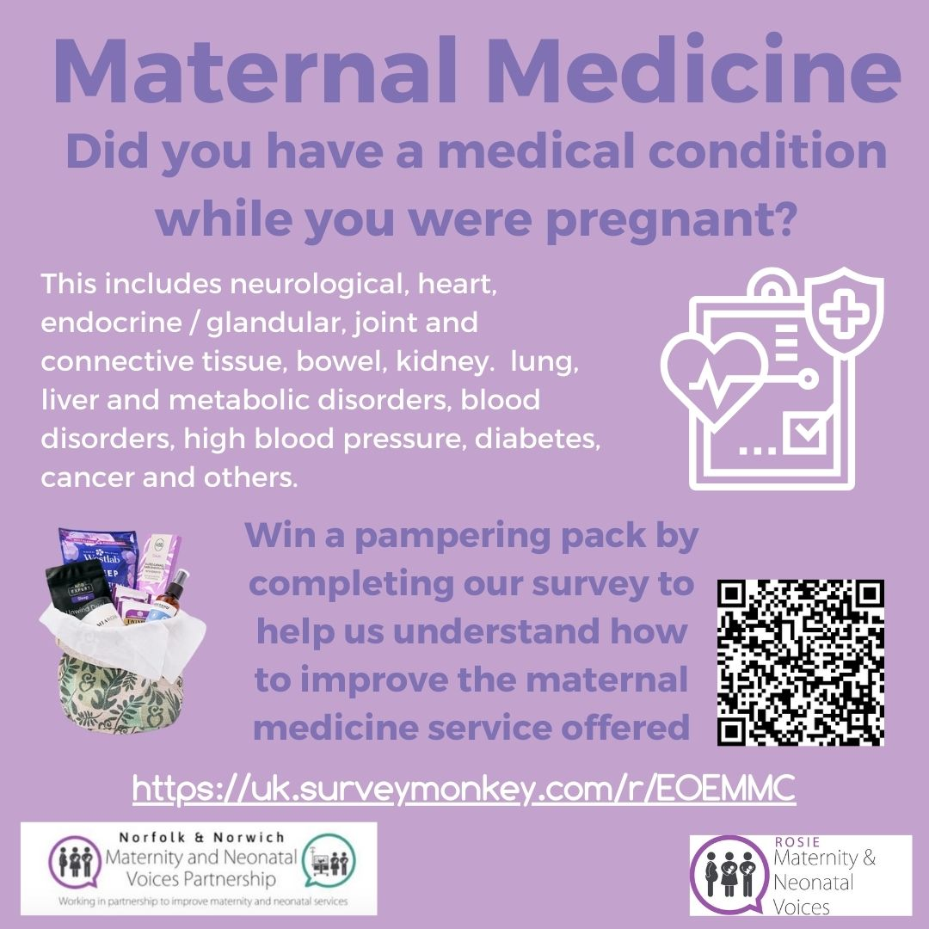
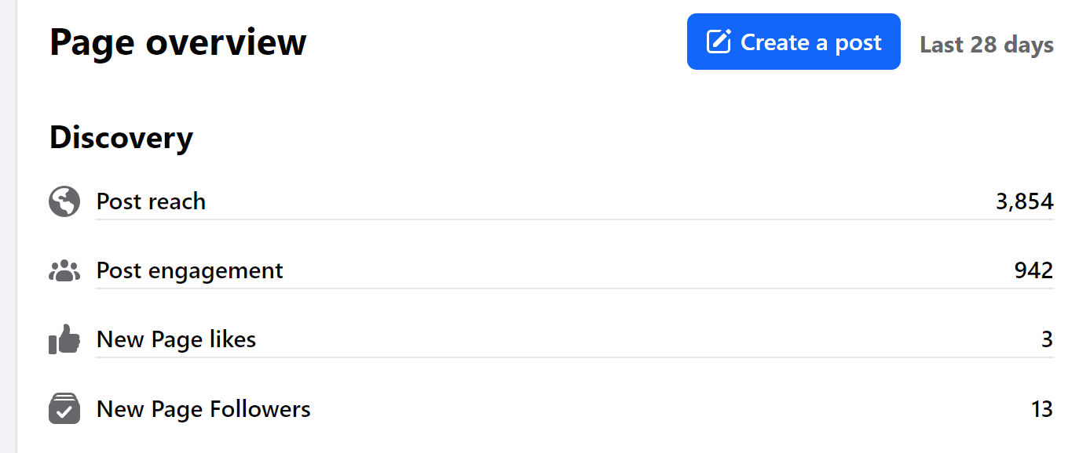
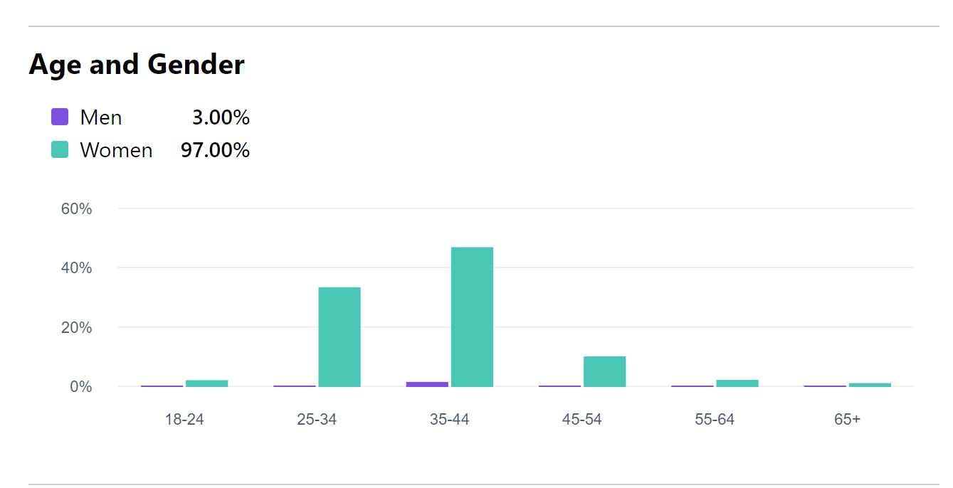
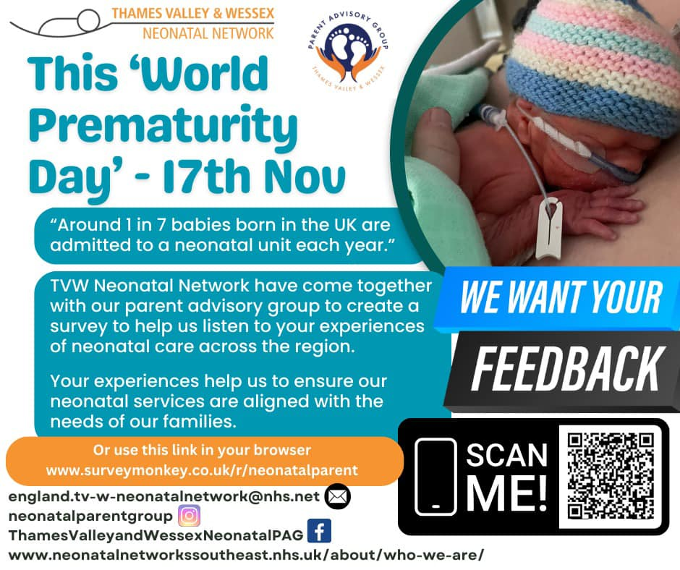
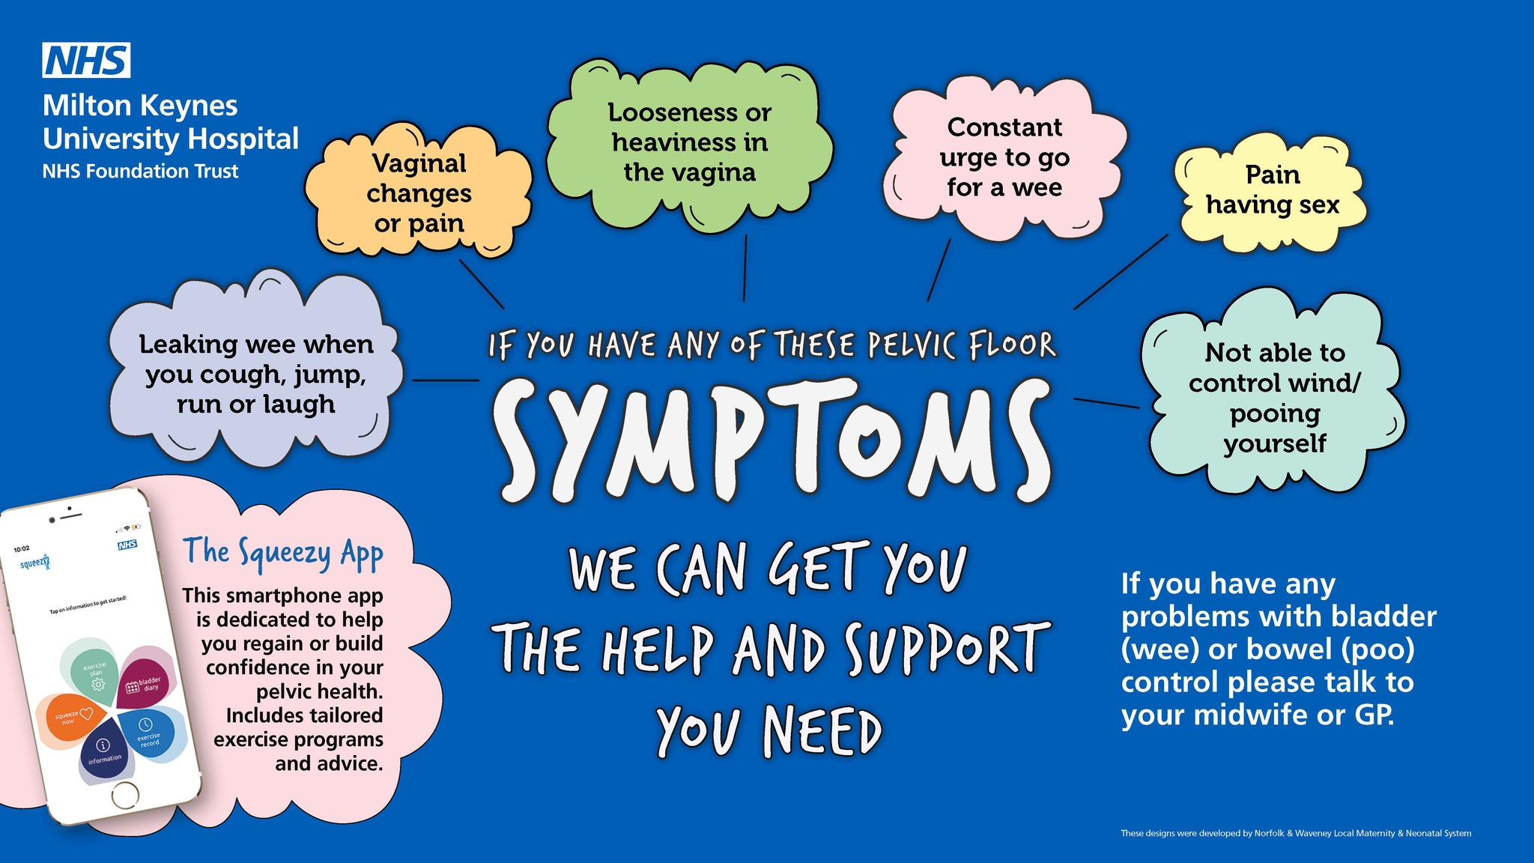
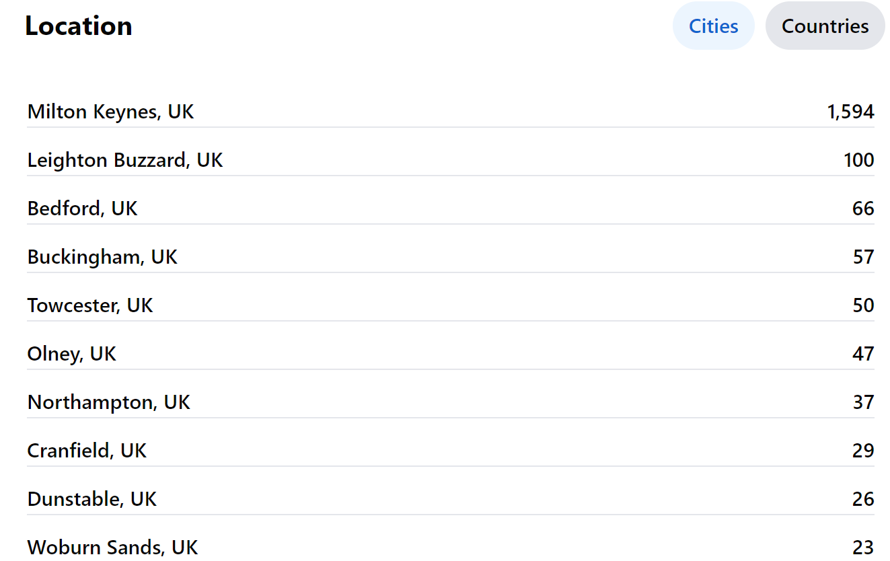
Social Media

Slide 11
Feedback Themes and Actions
Maternity Statistics Infographic post
-ongoing requests for information to be shared on % of inductions, caesareans, vaginal birth, assisted birth
- difficulty finding this data on the MKUH website or on national information sites
- it supports service user choice when deciding where to give birth
- in-line with what neighbour hospital sites produces infographics on monthly
UPDATE: Feedback on inclusion of Neonatal Information has been really positive in raising the awareness and also making these parents feel included on the infographic
UPDATE: MKUH will not be including % statistics on type of birth e.g C-section, Induction, Vaginal Birth, Assisted Birth. There is a national move away from reporting these statistics. The data is available via the maternity dashboard and link to this will be included when the monthly infographic is shared. The % reporting is also limited information without understanding the full clinical picture.

Slide 12
Feedback Themes and Actions

Slide 13
Feedback Themes and Actions
Caesarean Sections
- requests for Gentle c-sections/ maternal assisted c-sections - is this an option that can be supported at MKUH?
- clarity of language around the type of c-section, elected vs unplanned vs emergency ( elective implies choice which is not always the case) – these terms/definitions of caesarean can be very triggering and traumatic dependent on the experience and how the use of the term ‘emergency’ can instil fear
- what options are available for service users during c-sections e.g. music being played, lighting options, delayed cord clamping/ waiting for white, skin to skin,
- are options for caesarean discussed at birth preferences appointment
UPDATE – Planned updates to the enhanced recovery pathway guidelines, incorporating the feedback from service users. Review of the terminology and full guideline will be out for review soon which will be shared with the MVP to comment on. Application also submitted for additional funding to support project.

Slide 14
Service User Questions
ADAU:
options for pain relief if in labour and awaiting a bed on labour ward – experience being that gas and air is not available so only able to have pethidine injection which was not something wanted. Why is gas and air not available on ADAU?
MTLC/Perinatal Mental Health:
I would like to ask about the Birth Trauma services at MKUH. It is great to see this invaluable service.
Unfortunately, it is not something that seems to be widely known about and it would be great to be kept in the loop as a local private practitioner who supports many families experiencing trauma.
Please could some information about this service be sent out and what is the referral pathway for health professionals? Would it be; ask the parents to present to the GP if they are no longer under midwifery care?

Slide 15
Upcoming Projects/Work
Workplan – last quarter of the year – focus on workplan for new year along with funding and newly released guidance on the function and role of the MVP/MNVP
Protected Learning Time – MVP presentation to support understanding of the MVP amongst staff and share areas of good practice. Due to begin focused session with service user for specific experience feedback.
PROMPT
Induction of labour experience
Supporting personalised care and birth preferences

Slide 16
Thank You For Listening

