Slide 2
Finance Update
Spend Summary
Honorarium Payments for chairs | 21,600.00
Additional Hours claimed | 4,950.00
Chair expenses | 702.47
Service User Payments and Expenses | 493.41
Events and Marketing Materials | 3,117.60
Training | 125.00
Balance Forward | 18,028.25
Total Receipts | 26,984.19
Total Payments | 28,591.48
Year ending 22/23 | 16,420.96

Slide 3
Finance PLAn
Funding Awarded for 23/23 | 33,369.66
Additional funds awarded for pre-conception project work | 5,850.00
Total | 39,219.66
Co-chair funding - 12 days per month | 10,800.00
New Role - Enagagment Lead - 4 days per month | 7,200.00
New Role - Neonatal Lead - 2 days per month | 3,600.00
Chair expenses | 4,000.00
Service User payments and expenses | 2,000.00
Marketing/Events and unexpected costs | 2,500.00
Training | 1,000.00
Contingency fund - 3 months role hours only | 8,100.00
Total | 39,200.00

Slide 4
Updates
Centre:MK have now agreed and placed out leaflets in the Baby Change Area and are locating places for the MVP poster to be displayed.
Subscription to Mum to Mum Facebook group through GoToBusiness to help promote the MVP and direct people to the Maternity Voices page and survey. Allows for weekly posts in the group to promote the MVP and any surveys/projects etc. Currently the Mum to Mum group has 21,000+followers
Toddle About Magazine subscription – allows for advertising of MVP events and section on Toddle about website. Along. with quarterly printed half page advert. Building momentum – 80 clicks redirected to the BLMK Maternity Voices website.
New Maternity Voices website for BLMK www.maternityvoicesblmk.co.uk

Slide 5
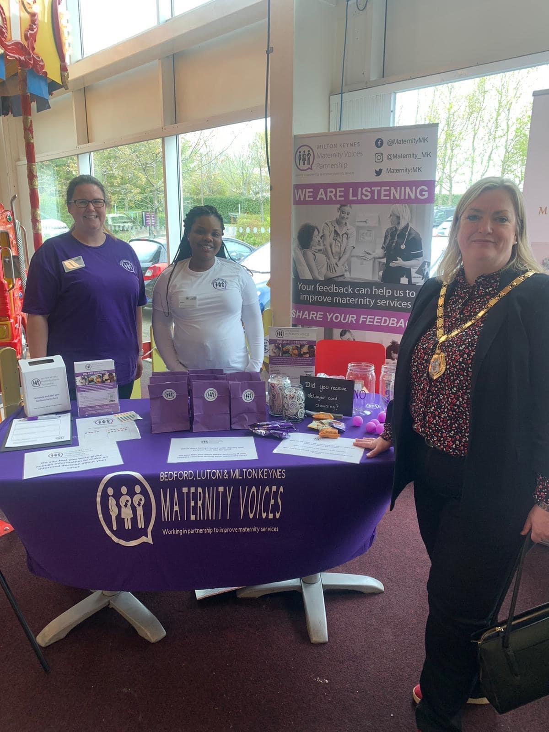
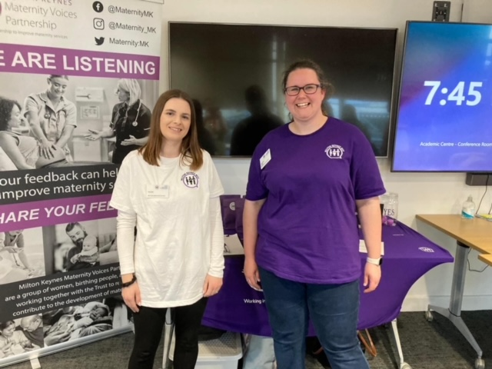
Updates
Events this Quarter:
360 Parent and Toddler Fayre – spoke to around 30 service users. Increased awareness of the MVP, around 80% had not heard of the MVP before. Huge amount of feedback received.
Meet The Team Event – MKUH maternity team and MKUH. Around 35 expectant parents spoken to and feedback on their experience so far and previous experiences.
Two online listening events – one at lunch and one in the evening.
Childrens centre mum and baby group attended

Slide 6
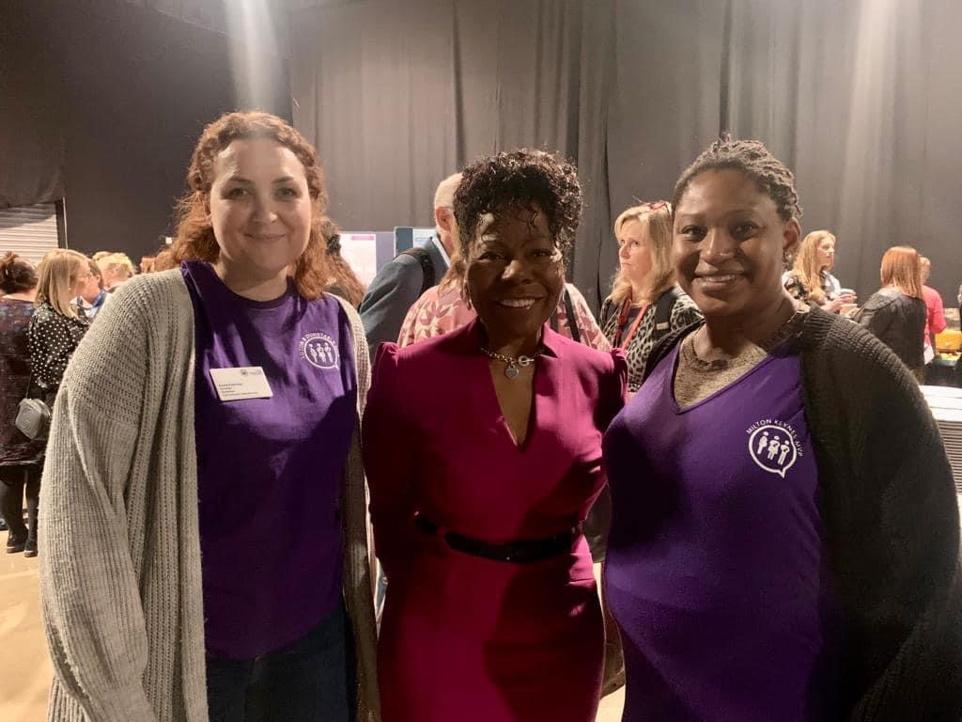
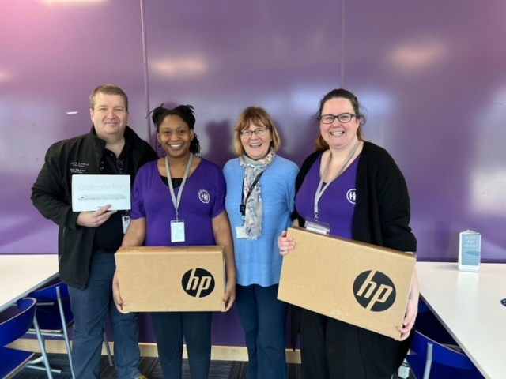
Updates
Temi attended the Maternity and Neonatal Summit in Leeds – real emphasis on MVP input and involvement in service development. She was also lucky enough to meet Jacqueline Dunkley-Bent (Chief Midwifery Officer for England)
IT equipment donated by JL – 2 laptops and a tablet!
Delivery of MVP ‘uniform’ - for each co-chair and t-shirts for when volunteers support us at face to face events

Slide 7
Feedback Themes and Actions
Gestational Diabetes – meeting with GDM midwives
Birth Reflections service and Debrief – liaised with Cat PMA and guidance and PIL currently under review
Labour ward refresh – some changes implemented following feedback.
Delayed cord clamping – is this standard and what is considered delayed cord clamping.
Thank you Thursdays via Social media to thank the staff and support staff wellbeing showing examples of excellent care
Infographic on statistics – not clear on figures for homebirth and waterbirth figures being so low. Met with comms to discuss and review.

Slide 8
Upcoming Projects/Work
Pre-conception project
Recruiting to new roles – if everyone is in agreement this is a good use of funds
Purchase of additional promotional materials for events
International Day of the Midwife
Organising 2 more online listening events in May/June
Working with MKUH to review current workplan in line with the new Single Delivery plan for maternity services and review of current workstreams to reflect funding and capacity

